Slide 1

Source

Slide 2



Welcome to Week 13
Lecture 1!
Intro to MySQL,
MySQL Workbench,
GitHub Desktop,
& Jupyter Notebooks

Slide 3
Agenda
Progress Check & Assignments
Today’s Topics:
GitHub / GitHub Repositories
Using GitHub Desktop
Using Jupyter Notebook
Using MySQL Workbench - Generating an ERD
Walkthrough: Creating an Assignment Repo + Notebook
Querying MySQL with Python
Thursday’s Topics:
Advanced SQL Queries
Database Administration
Exporting MySQL Databases

Slide 4
Progress Check
Local Python Installation.
Poll 1:
Have you been able to install Python locally and your Setup your dojo-env successfully? [Link]
Poll 2:
For those that ran into problems installing Python + dojo-env, where did you get stuck? [Link]
MySQL Server/Workbench
Poll 3:
Have you been able to install MySQL Server + MySQL Workbench Successfully? [Link]
Notes:
Poll 1 Admin Link: https://www.polleverywhere.com/multiple_choice_polls/I5nx3ZE7fOjWdGVvCatcI
Poll 2 Admin Link: https://www.polleverywhere.com/multiple_choice_polls/nCNuyTrPu3DJdbfdEjqd6
Poll 3 Admin Link: https://www.polleverywhere.com/multiple_choice_polls/m5oIJqBamCC5kb1dVl6e6

Slide 5
Assignments
Core Assignments for this Week:
Queries: Sakila (Core)
Books (Core)
Project 3 - Part 1 (Core)
Assignment Deadline - This Week:
Extended until Sunday night 11:59 PM PST
Allows time for installation troubleshooting
More lecture time to cover everything needed.

Slide 6
GitHub & GitHub Desktop

Slide 7
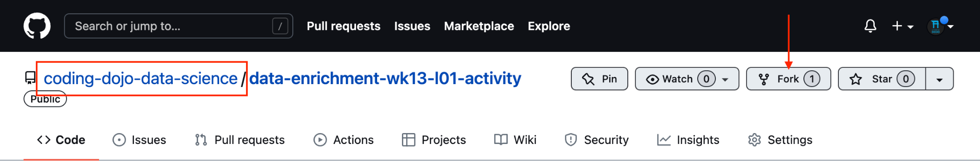
GitHub Repositories & Version Control
A GitHub repository is a version-controlled folder containing code and related files.
By “version-controlled”, we mean that GitHub tracks every change made to all files within a repository.
The changes are saved as a snapshot of each file at that point in time, called a “commit”.
This allows us to retrieve any previous snapshot of our work, if we need to.
Repositories are owned by a specific GitHub user. Only that user can change the contents of a repo. In the screenshot below, you can see that this repo is owned by “coding-dojo-data-science”.

Slide 8
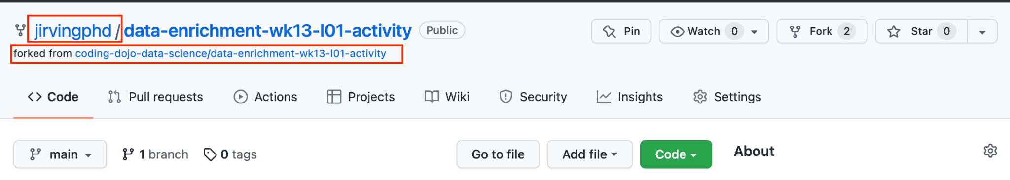
Forking a Repo
To Fork a repo, click on the “Fork” button on the repo on GitHub.com
It will then open a new copy of the repository, but attached to YOUR username. It will also indicate what repository it was forked from.

Slide 9
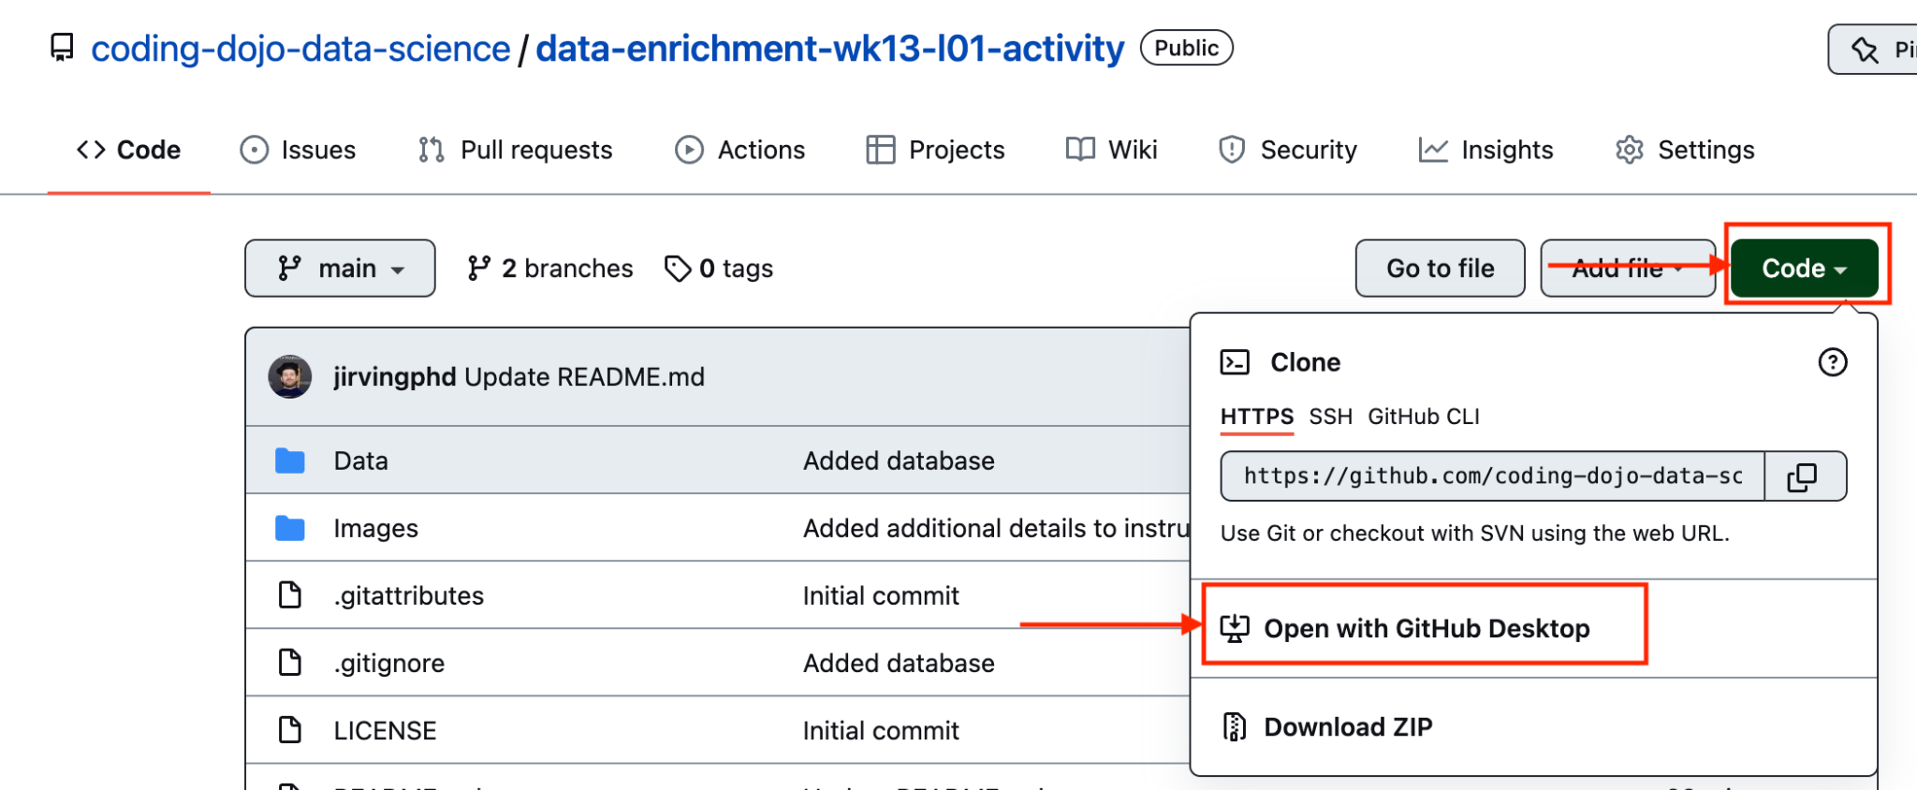
Opening a Repo Locally - 1
Click on green Code button and select Open in GitHub Desktop

Slide 10
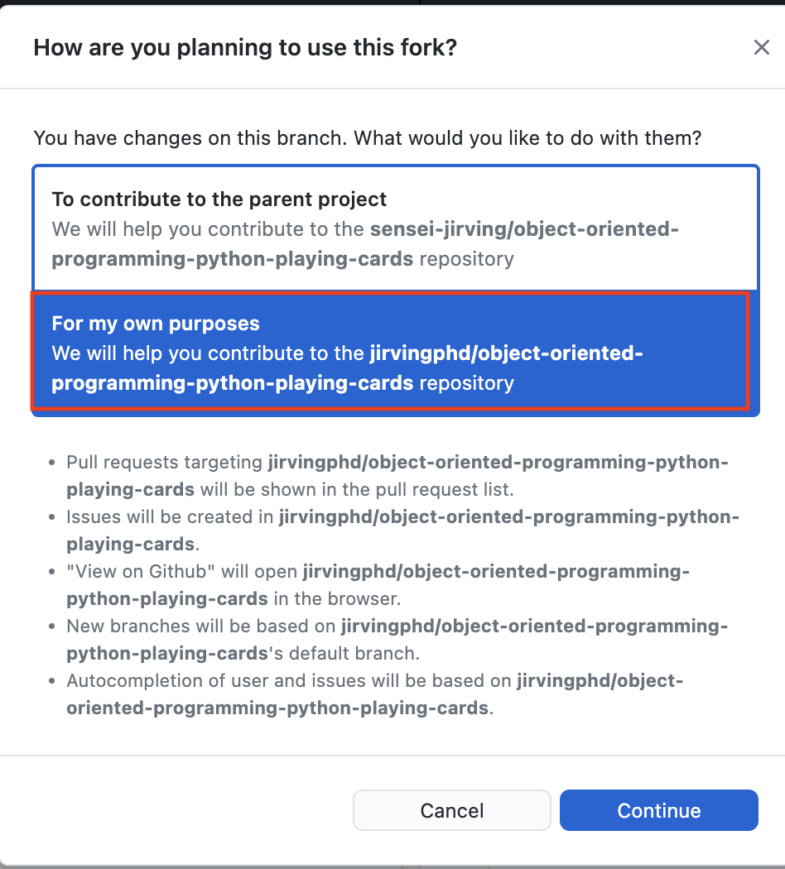
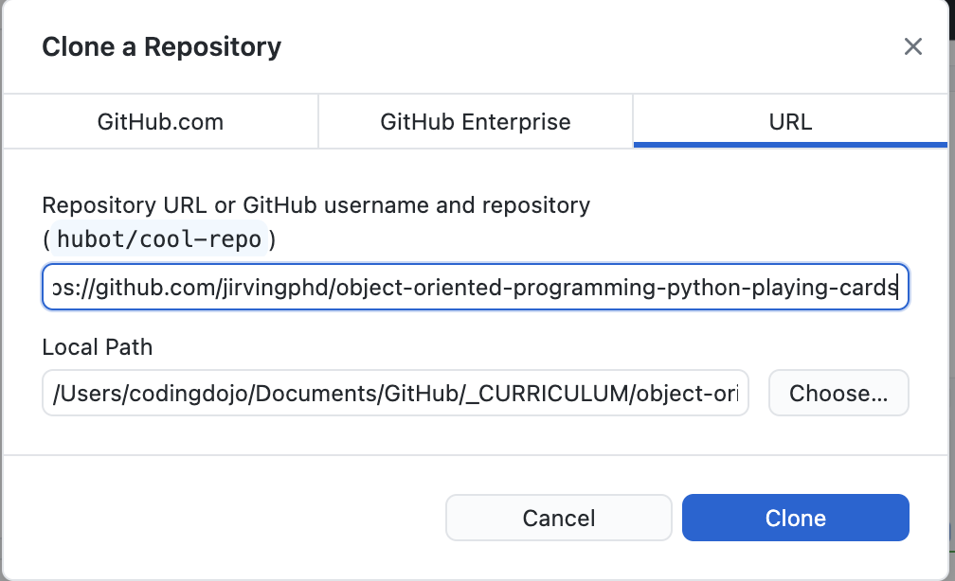
Opening a Repo Locally - 2
2. Select a folder to clone the repo into and click “Clone”.
2. When asked “How are youn planning to use this fork”.
Select “For my own purposes”

Slide 11
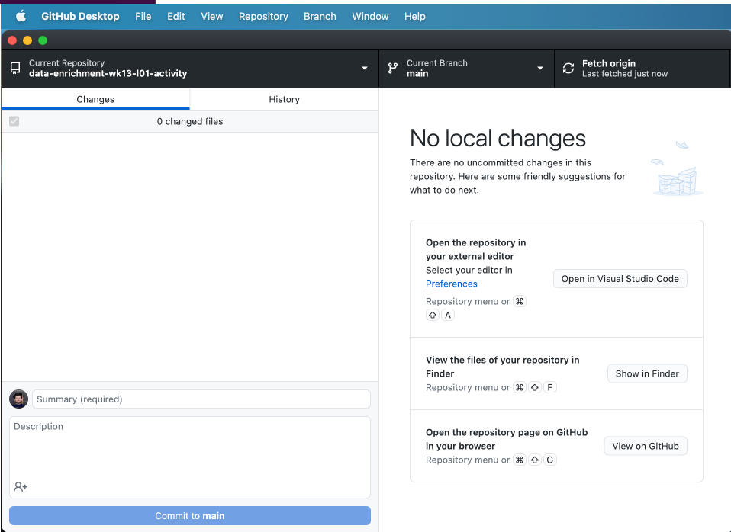
GitHub Desktop Interface
To Open Repo in Jupyter:
Click on the “Repository” menu on the menu bar/top of the window.
Select “Open in Terminal”/”Open in GitBash”
In the terminal/GitBash window, start jupyter notebook by running: “jupyter notebook” or “jnb” (if you added the alias as shown in step 3. Setting dojo-env as your default)

Slide 12
Jupyter Notebook

Slide 13
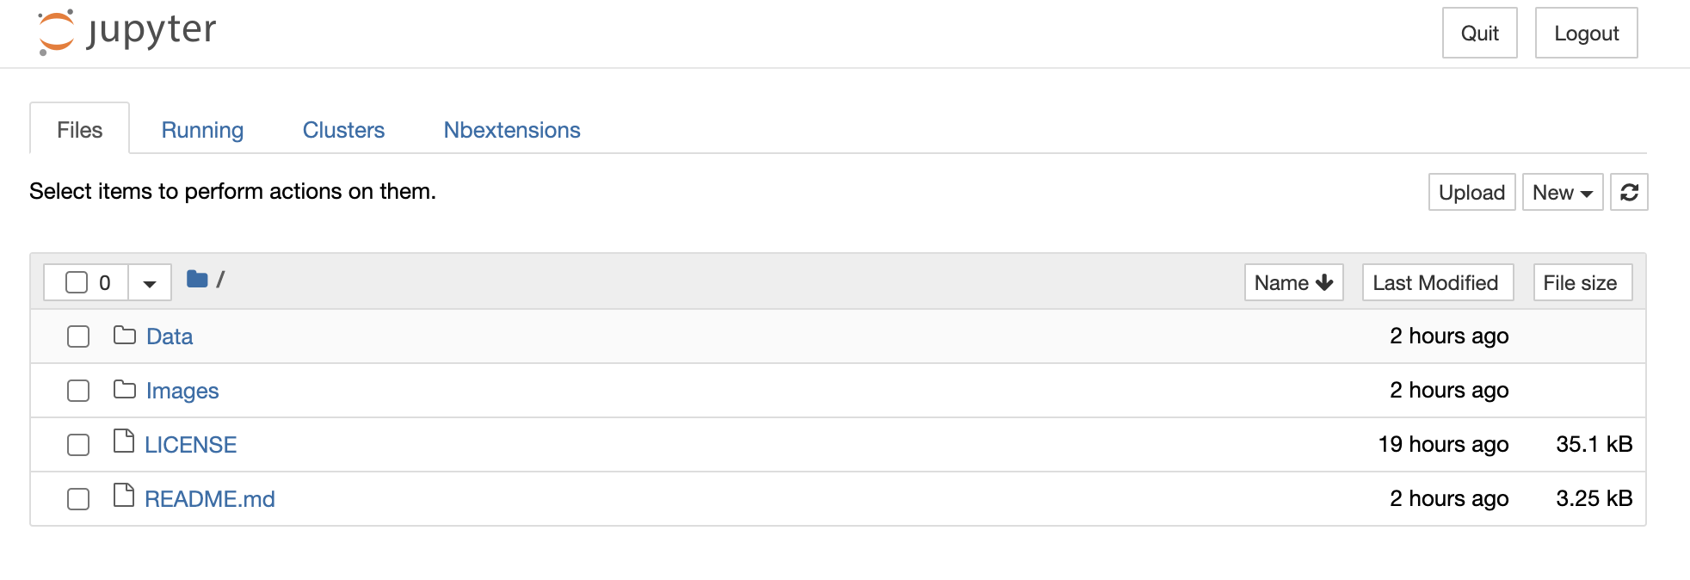
Jupyter Notebook Interface - Files View

Slide 14
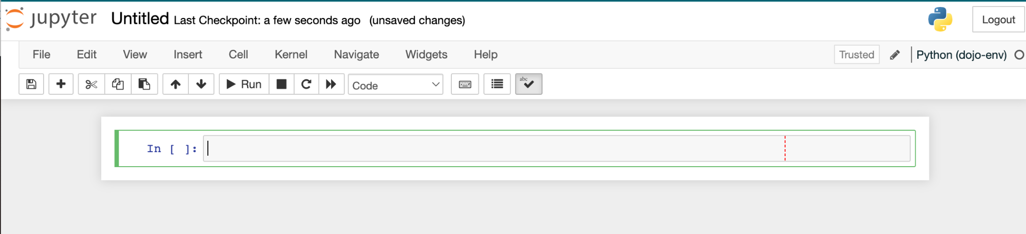
Jupyter Notebook Interface - Editor

Slide 15
Walkthrough/Activity: Practicing SQL Queries with Python
Using GitHub Desktop, Jupyter Notebook, MySQL Workbench, and PyMySQL Together

Slide 16
Group Activity Details
For today’s activity, you are going to be practicing working with GitHub Desktop, Jupyter Notebook, and MySQL Workbench.
Full instructions are in the README: https://github.com/coding-dojo-data-science/data-enrichment-wk13-l01-activity
Brief Summary:
Fork and clone the GitHub repository:
Open the repo with Jupyter and create a new notebook.
Install the Chinook database into your MySQL Server.
Use Reverse Engineering in MySQL Workbench to create an ERD for the Chinook database you just installed.
Use PyMySQL and Sqlalchemy to perform the correct queries to answer the listed queries.
We will walk through the first 4 steps together before we split into breakout rooms.

Slide 17
Breakout Group Time!
Get as far as you can working with your group!

